Slide 1
Unit 3 going global

Slide 2
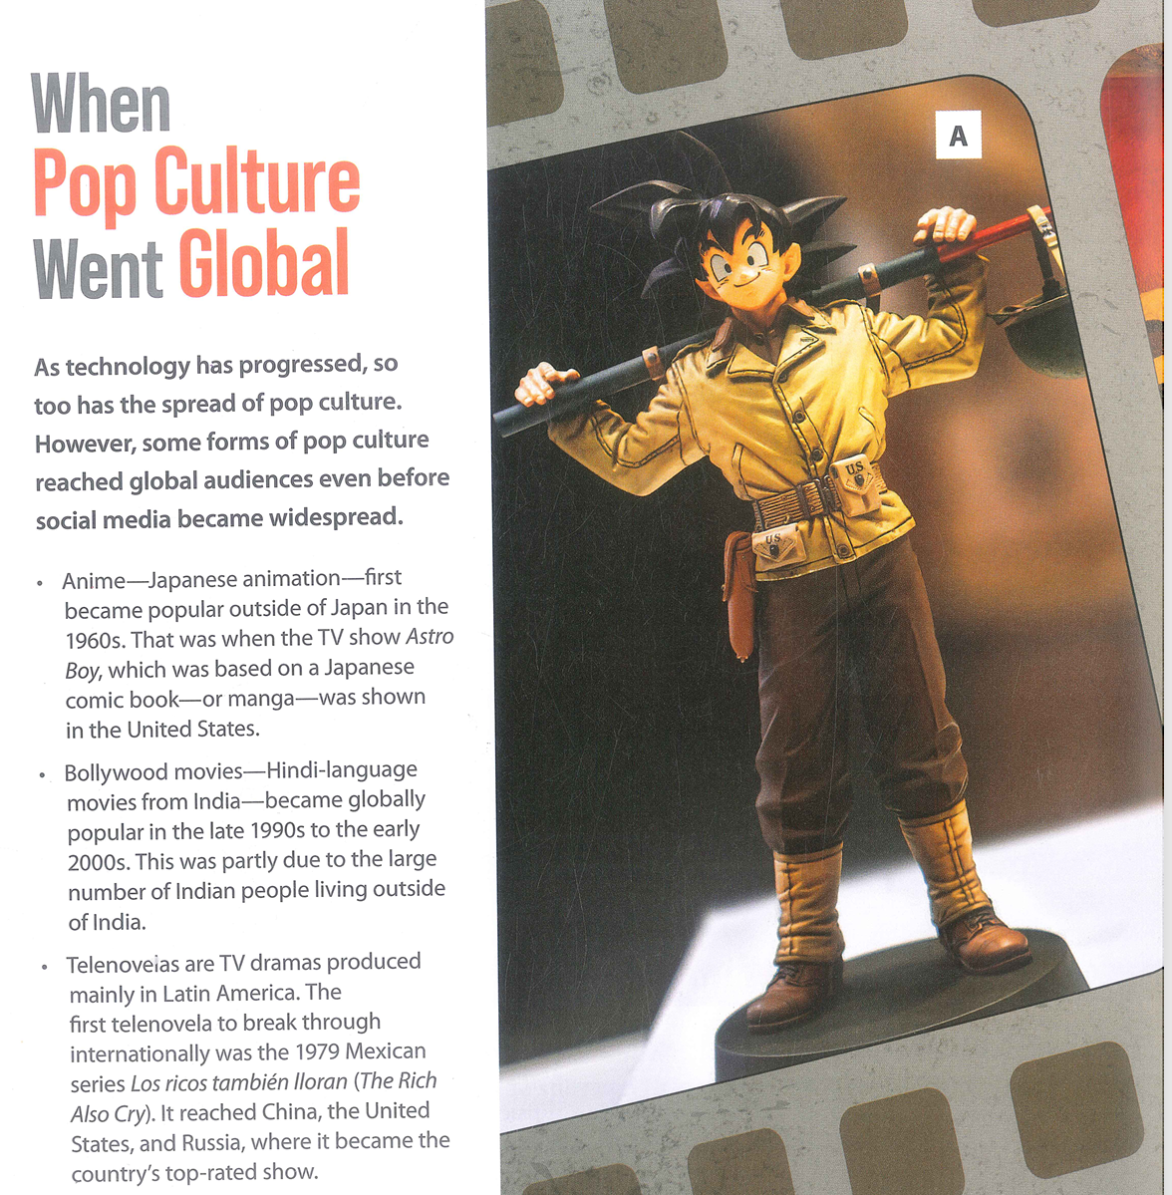
Lead-in

Slide 3
Reading 1

Slide 4
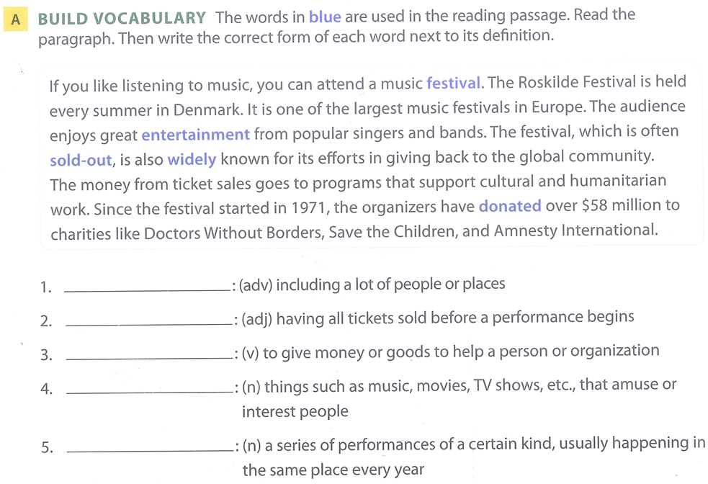
Language development – p. 44
(adj/ N) /hjuːˌmæn.ɪˈteə.ri.ən/: connected with helping people who are suffering and improving the conditions that they are living in
widely
Sold - out
donate
entertainment
festival

Slide 5
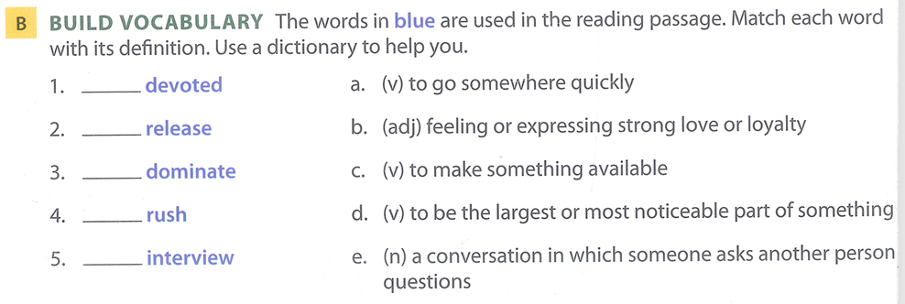
Language development – p. 44
b
c
d
a
e

Slide 6
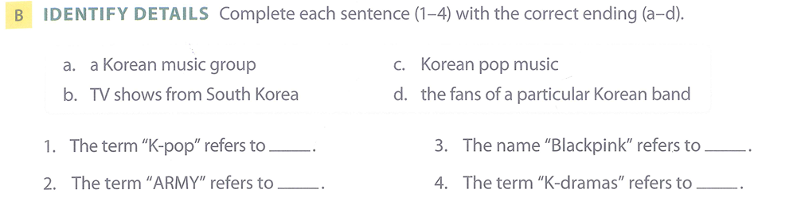
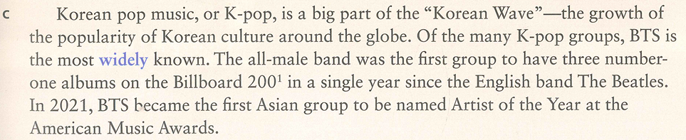
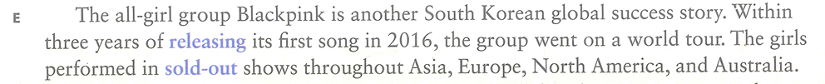
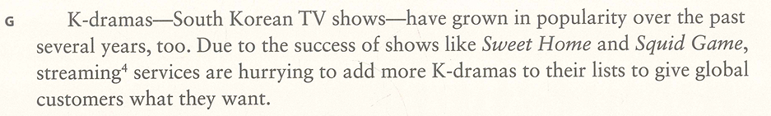
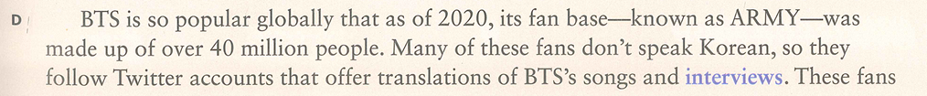



Reading comprehension – details (p. 47)
1. Matching
c
a
d
b

Slide 7
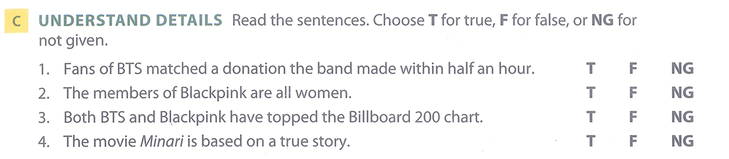
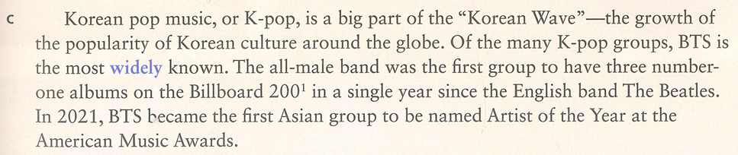
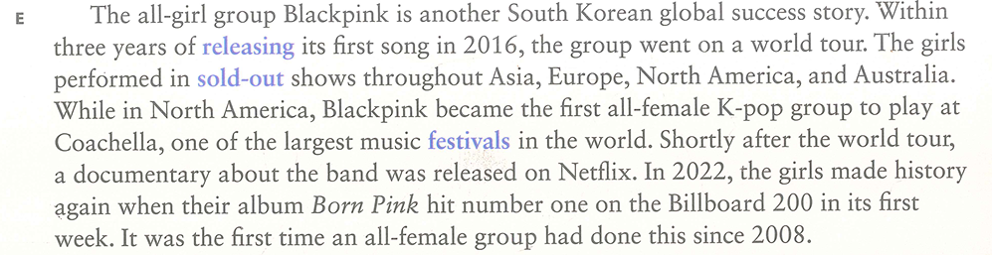
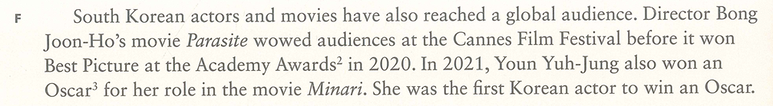



Reading comprehension – details (p. 47)
2. True/ False/ Not Given

Slide 8
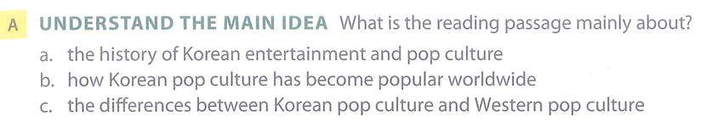
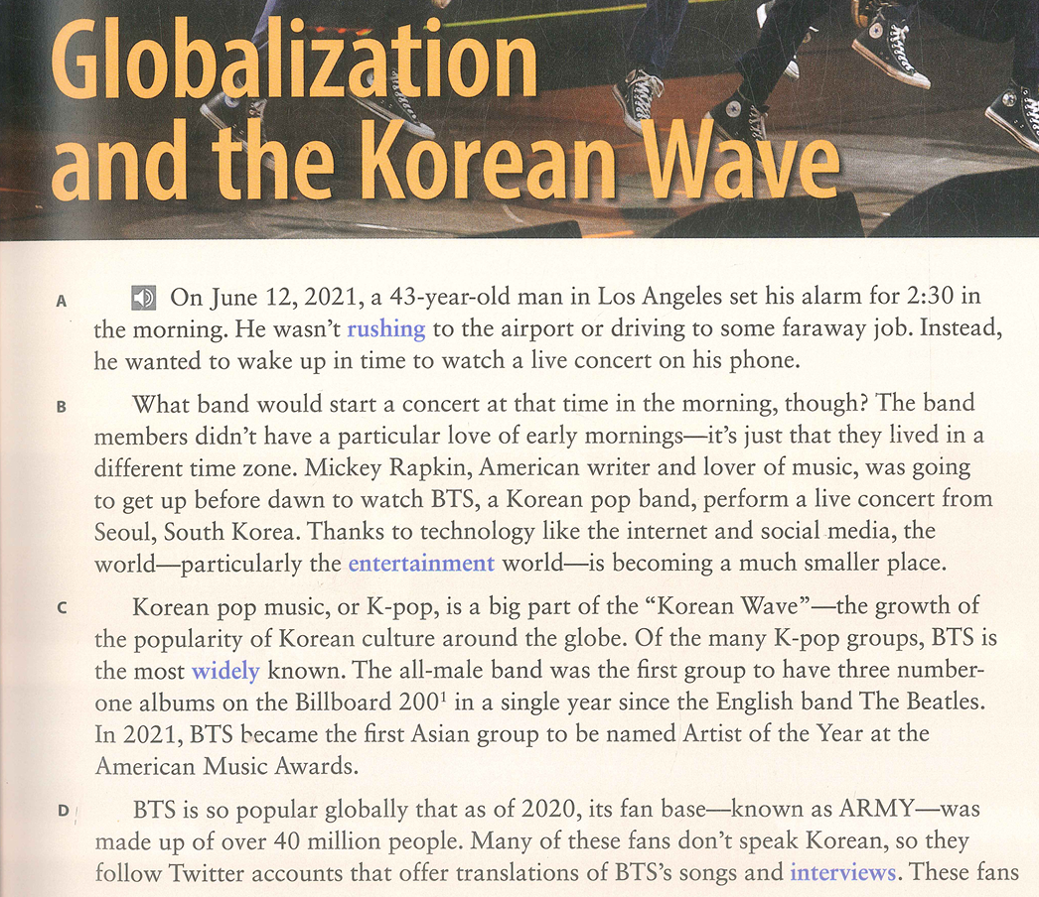
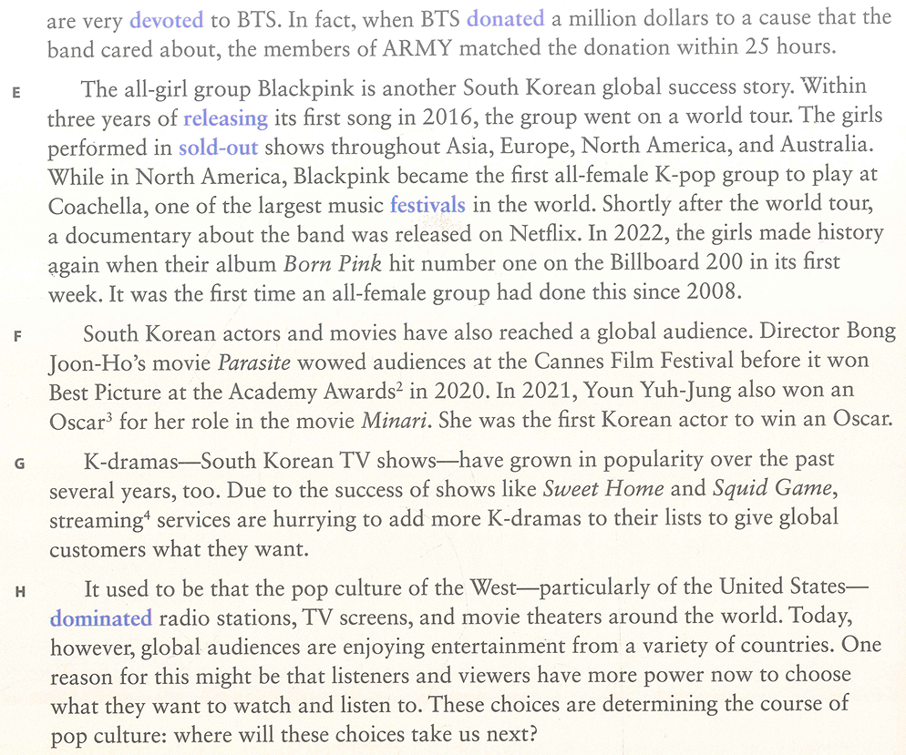
Reading comprehension – the main idea (p. 47)
3. Multiple choice questions (MCQ)

Slide 9
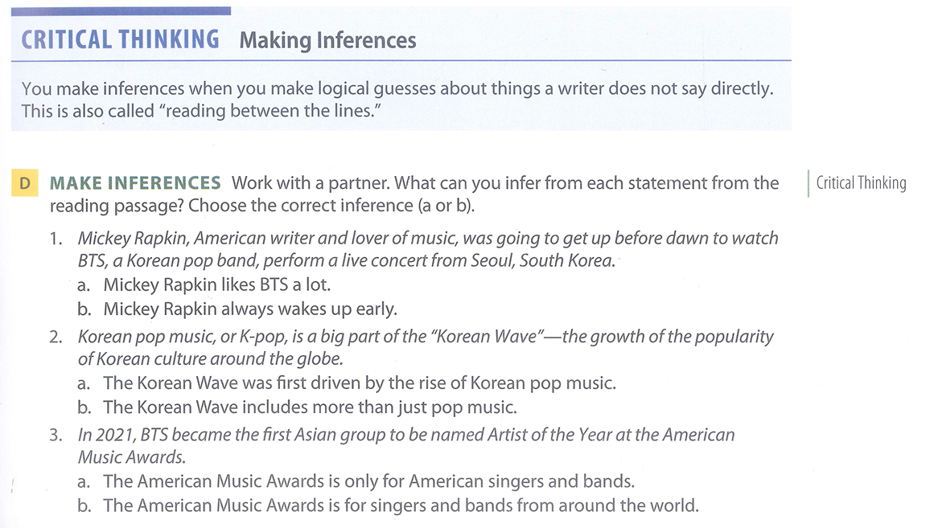
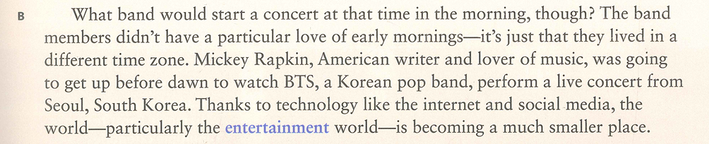
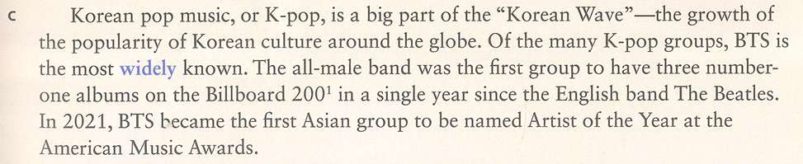

Comprehension check – inference questions

Slide 10
progress test 1

Slide 11
Reading 2

Slide 12
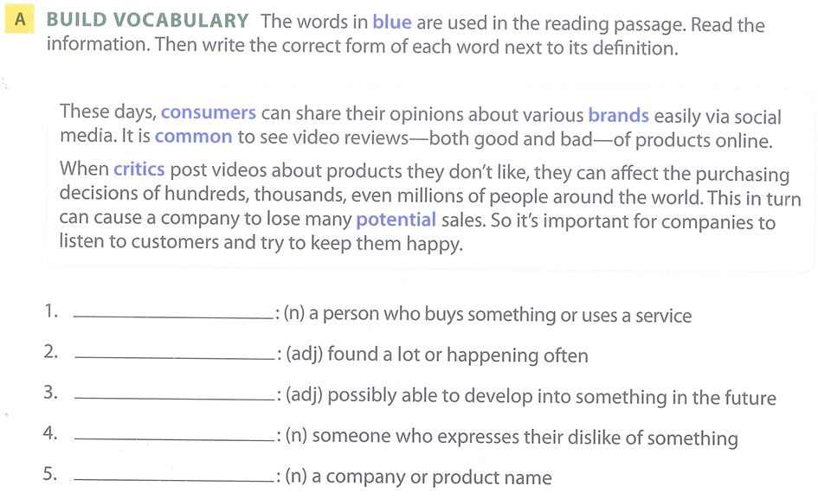
Language development – p. 50
consumer
common
potential
critic
brand

Slide 13
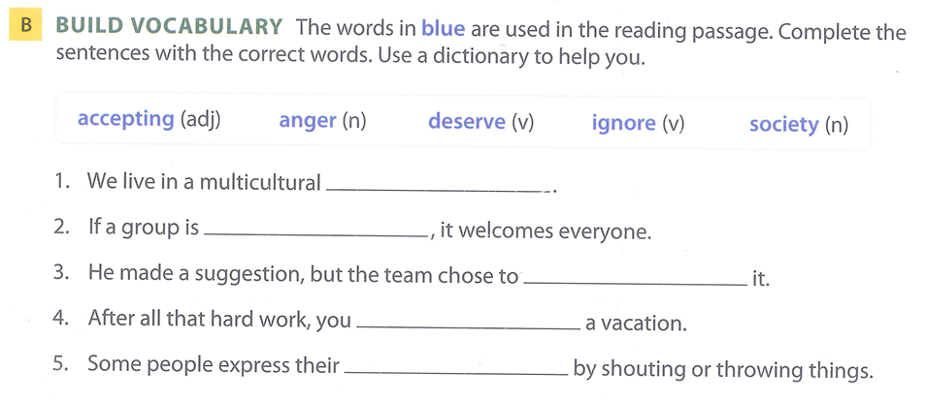
Language development – p. 50
society
accepting
ignore
deserve
anger

Slide 14
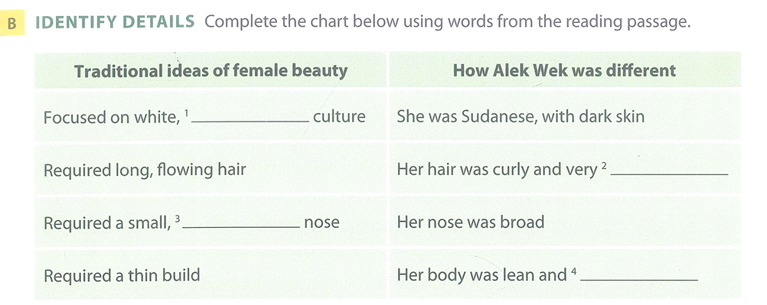
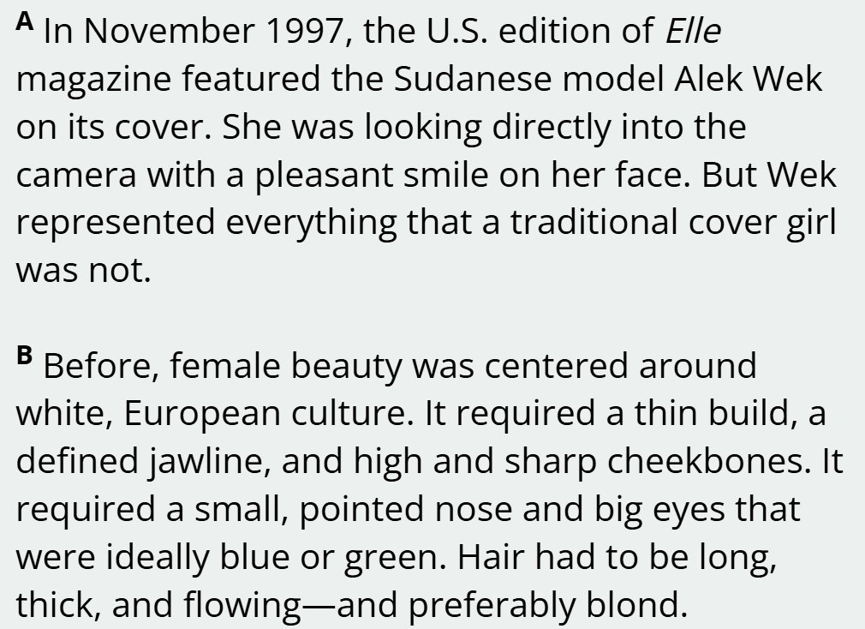
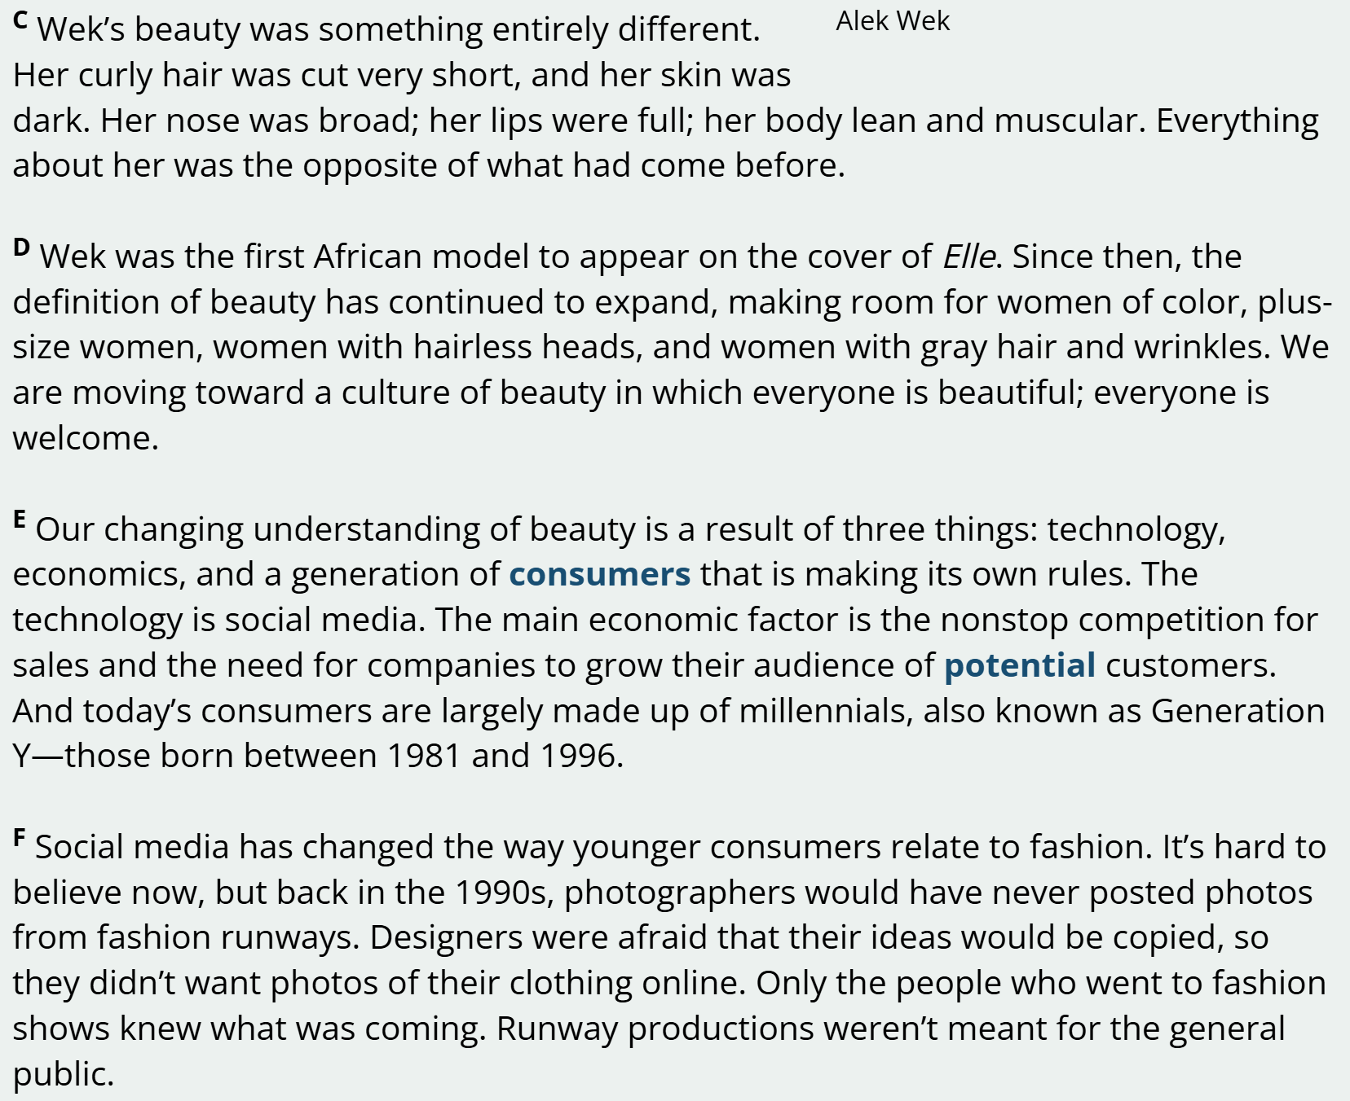


Reading comprehension – details (p. 53)
1. Table completion
European
short
pointed
muscular

Slide 15
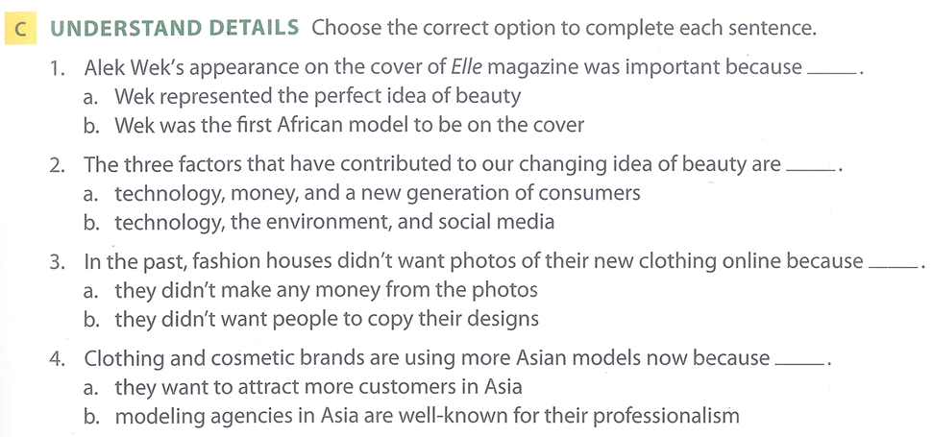






Reading comprehension – details (p. 53)
2. Multiple choice questions (MCQ)

Slide 16
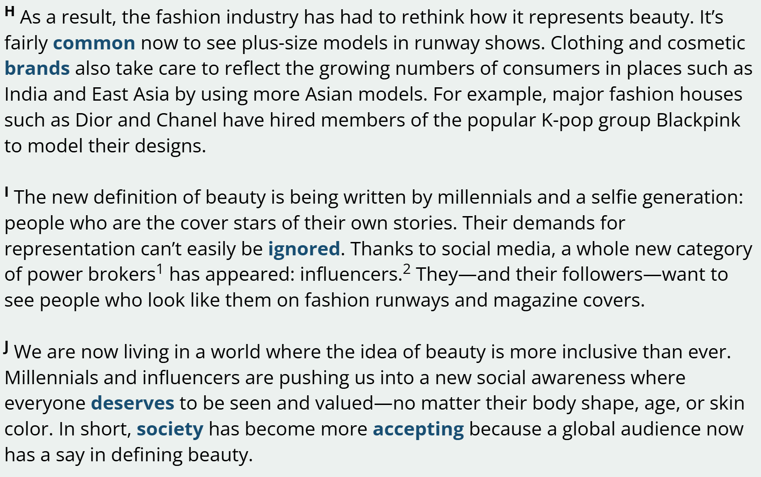



Reading comprehension – details (p. 53)
2. Multiple choice questions (MCQ)

Slide 17
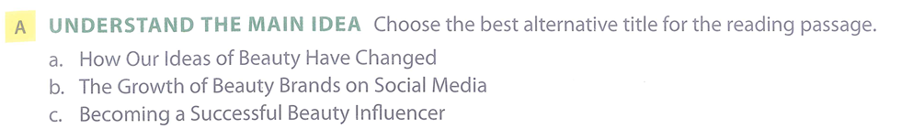
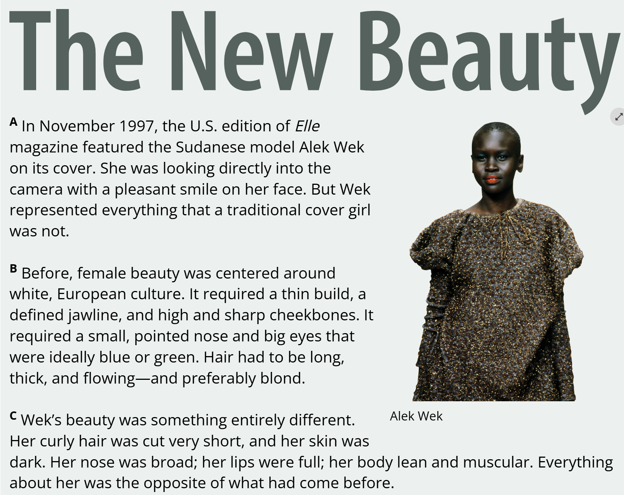

Reading comprehension – the main idea (p. 53)

Slide 18
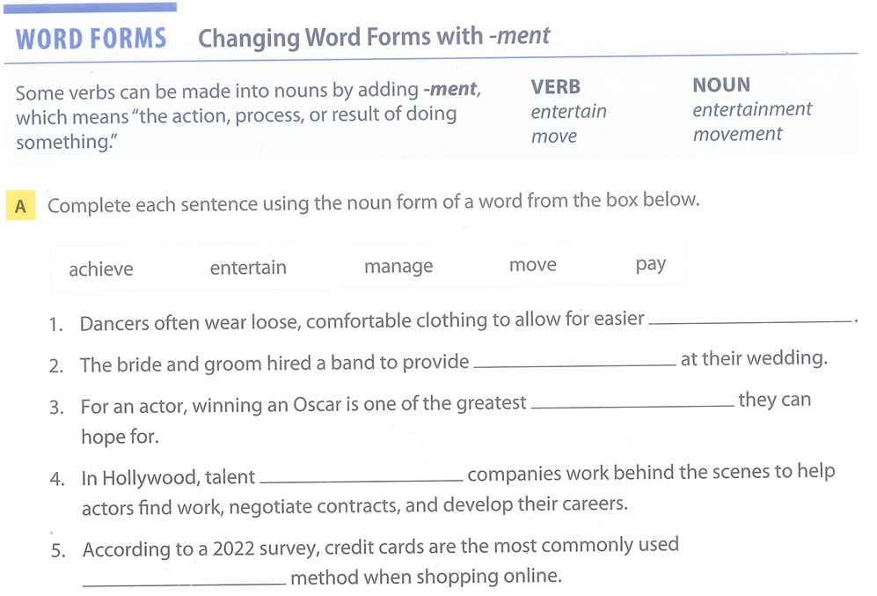
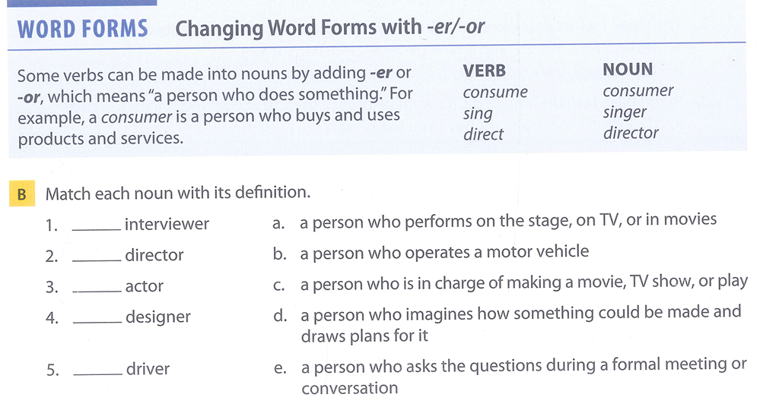
Vocabulary extension – p. 54
movement
entertainment
e
c
achievements
a
management
d
b
payment

